Slide 1


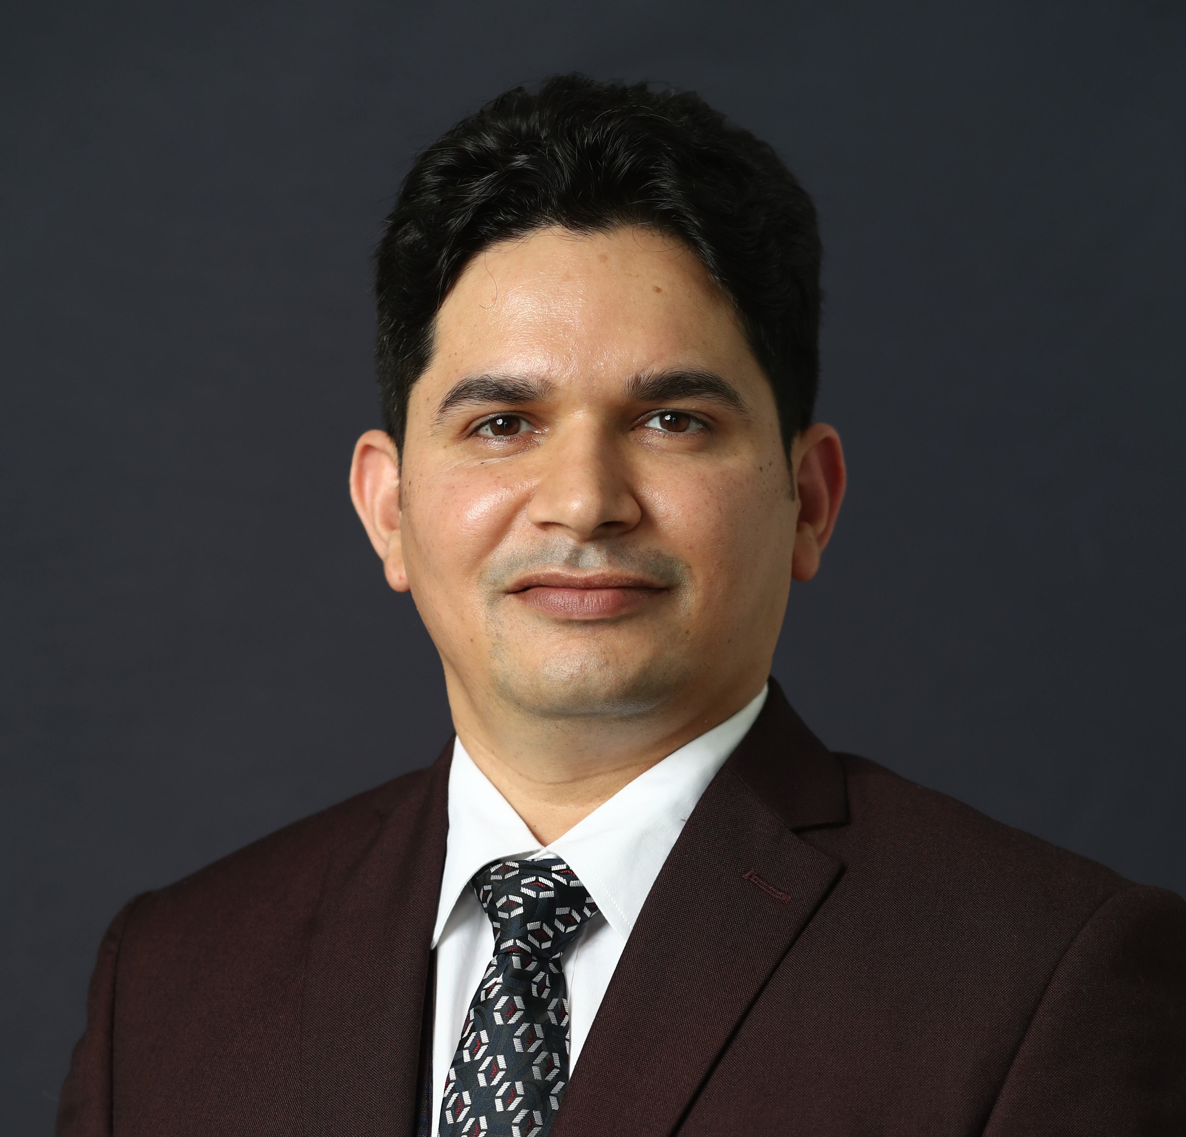

How To Multiply Your Turnover

Slide 2
We are into TURNOVER BUSINESS
We are NOT recruitment Agency

Slide 3
Growth- Turnover
Existing Team – Productivity Increase
150 PPV
Big Challenge of Repurchase ..??
5 LLC
Customer Service is Must
Maintain a Customer Record – Be A AMAZON of Your Colony/Society
Winning Formula-
You – 10 Customers x 3000 Rs = 30000 rs
Help/Develop 10 Leaders in your team to do the same-
10 Leaders x 10 customers each (avg -3000 rs )= 100 customers x 3000 Rs = 3 Lac Turnover

Slide 4
How to Sponsoring with – 12000 Rs
Ask Right questions to get started with -12000 rs ( fast track 8 %)
Que- How Much monthly Income you want to earn from Vestige in next 6 month- 1 year
Ans- 50- 1 lac
Que- How much money, time, efforts is required to earn this income from traditional business/ job
Que- If you have 50 k salary right now. If you want get 50 k monthly increment in your salary- how many many years will it take
Ans- in JOB – 10 to 15 years, No Guarantee
Ans- In Business- Money – 10-20 lacs, Time -5 yrs , Efforts- 10-12 hrs / Days

Slide 5
Let the Prospect decide joining amount
- In vestige business opportunity you can EARN 50 K to 1 lac / Month in next 1 year for sure. See the Success Stories.
Que- How much MONEY, TIME, Efforts you are ready to invest
( Jo income traditional way me 10 -15 saal me aati hai wo income vestige me 1 ssal me aa sakti hai – create excitement)
Ans- Prospect will speak 25-50000 rs easily- Let the Prospect Decide

Slide 6
Where is your Focus ???
Consumer Plan
Challenges you face
Joining without purchase/ follow up for order
There is no Sense of urgency
Market is full of FMCG products/ lots of variety/ PRICE comparision
FOCUS on DREAMS
Health Plan
Advantage
Order ready after Plan
Sense of urgency
No Price Comparison/ More options
High PV products
Retention is Higher

Slide 7
Vestige- Wellness Driven Company
When you introduce yourself – Wellness advisor/ Consultant
People will respect you
Your acceptance will be better in Higher class/ well to do families.
Per person order value will increase
For Weight management or any health condition-2- 3 month course can be booked
Once the person get good results from Supplements he becomes promoter/ business builder

Slide 8
Profitable = Cheque size
Right Structure + Volume = Profitable
Core
Go-Getter
Crown Club
Personal Volume
New Sponsoring with 12000 Rs
LOB

Slide 9
PIN
Or
PAISA… ????

Slide 10
Right Approach
Step 1- Cheque/ income..????? (eg- 1 lac/ month)
Step 2- PIN (eg - CROWN)
Step 3- Turnover (eg- 15 Lac)
Step 4- How many Legs…?? (eg -6 to 8 legs )
Step 5- How Many plan Shower in team ???

Slide 11
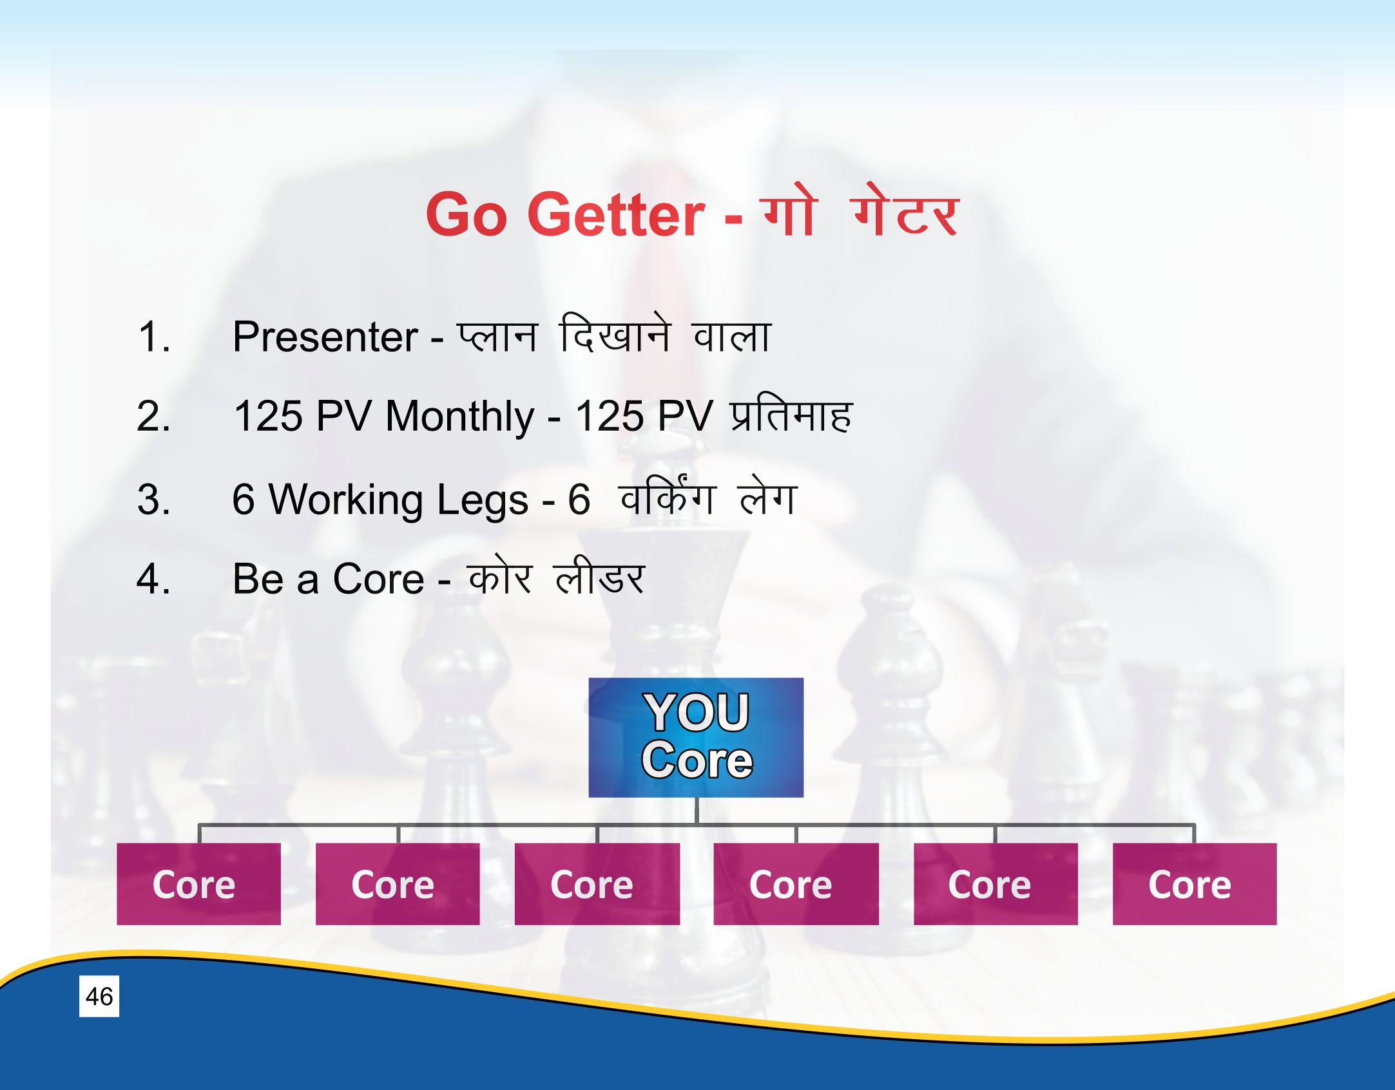
6 month GAME PLAN for crown with - 1 lac Plus Cheque
Step 1- Go fast Track Silver Director ( 5625+ 2800 = 8425 GPV )
( Sponsor 22 people with 12000 rs = 2.64 lac turnover- Cheque 25-30 K)
Step 2- Help your Downline to Qualify Silver Director (8425 PV)
( Focus one leg in one month, 6 month- 6 qualified legs)
Step 3- Consolidate- Develop Leadership in each leg to maintain 3 lac plus biz every month

Slide 12

Weekly Review
Core – 150 PPV, PAC
Daily Volume – Productivity
Customer Record Maintain
4-5 New Name Addition in LIST
Fast Track Join – 400 PV – with Winning Team Starter Pack
WT function/ Team Meetings – Promotion/ How many Nos.??
How Many New CEP

